Slide 1
Lesson 2
My first machine learning model from Scratch
1

Slide 2

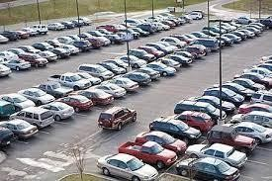
Teach a machine to identify vehicle types
2

Slide 3
3

Slide 4
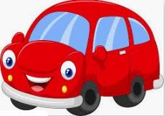
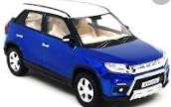


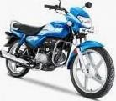
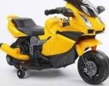
Represent the sample
#Wheel Height Weight Color
4

Slide 5
Represent the sample
#Wheel Height Weight Color
Identify the features which can represent the objects
𝑭 = {𝒇_{𝟏} 𝒇_{𝟐} 𝒇_{𝟑} … 𝒇_{𝒌} }
Feature set={ #Wheel
Height
Weight
Color }
5

Slide 6
Represent the sample
#Wheel Height Weight Color
Identify the features which can represent the objects
𝑭 = {𝒇_{𝟏} 𝒇_{𝟐} 𝒇_{𝟑} … 𝒇_{𝒌} }
For every sample, assign value to corresponding feature
𝒗_{𝒊} = {𝒘_{𝒊𝟏}𝒘_{𝒊𝟐}𝒘_{𝒊𝟑} … 𝒘_{𝒊𝒌} }
where 𝒘_{𝒊𝒋} is the value assigned for the feature 𝒇_{𝒋}
6

Slide 7
Represent the sample
 | #Wheel Height | Weight | Color
 | 4 6 | 500 | Red
 | 4 5.5 | 600 | Blue
 | 4 5 | 550 | Yellow
 | 2 3 | 200 | Red
 | 2 3.5 | 150 | blue
 | 2 4 | 250 | Yellow
For every object, assign value to corresponding feature
𝒗_{𝒊} = {𝒘_{𝒊𝟏}𝒘_{𝒊𝟐}𝒘_{𝒊𝟑} … 𝒘_{𝒊𝒌} }
where 𝒘_{𝒊𝒋} is the value assigned for the feature 𝒇_{𝒋}
7

Slide 8
Vector Space Model
 | #Wheel | Height | Weight | Color
 | 4 | 6 | 500 | Red
 | 4 | 5.5 | 600 | Blue
 | 4 | 5 | 550 | Yellow
 | 2 | 3 | 200 | Red
 | 2 | 3.5 | 150 | blue
 | 2 | 4 | 250 | Yellow
Features Vectors
This form of representation is called Vector Space Model

Slide 9
Are all features useful?
Features
#Wheel
Height Weight Color
Features Vectors
4 | 6 | 500 | Red
4 | 5.5 | 600 | Blue
4 | 5 | 550 | Yellow
2 | 3 | 200 | Red
2 | 3.5 | 150 | blue
2 | 4 | 250 | Yellow
Good Features
#Wheel
Height
Weight
Bad Feature
Colour

Slide 10
Let us consider single feature
#Wheel 4 | Class Label CAR | Training Dataset
 |  | Feature vector with Class label
4 | CAR
4 | CAR
2 | BIKE
2 | BIKE
2 | BIKE

Slide 11
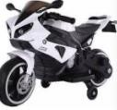
Given the #Wheel, identify the vehicle
#Wheel
4
Class Label
CAR
4
CAR
4
CAR
2
BIKE
2
BIKE
2
BIKE
2
?

Slide 12
Let us estimate
#Wheel
4
Class Label
CAR
4
CAR
Pr(Vehicle type| #Wheel) = ?
4
CAR
2
BIKE
2
BIKE
2
BIKE

Slide 13
Let us estimate the probability (type|#wheel)
#Wheel Class Label
4 CAR
Pr(CAR| 4) = 100%
Pr(BIKE| 4) = 0%
4
CAR
4
CAR
Pr(CAR| 2) = 0%
Pr(BIKE| 2) = 100%
2
BIKE
2
BIKE
2
BIKE

Slide 14
Ask the question now
#Wheel
Class Label
4
CAR
Pr(CAR| 4) = 100%
Pr(BIKE| 4) = 0%
4
CAR
4
CAR
Pr(CAR| 2) = 0%
Pr(BIKE| 2) = 100%
2
BIKE
2
BIKE
{2}
?
2
BIKE
Classifier Pr(BIKE|2) > Pr(CAR|2) => BIKE
2
BIKE

Slide 15
There are multiple ways
#Wheel
Class Label
CAR
4
4
CAR
4
CAR
1
3
5
2
BIKE
BIKE
CAR
#Wheel
2
BIKE
2
BIKE

Slide 16
There are multiple ways
#Wheel
Class Label
CAR
4
4
CAR
4
CAR
1
3
5
2
BIKE
BIKE
CAR
#Wheel
2
BIKE
2
BIKE
Classifier
If #Wheel < 3, then it is BIKE
2
BIKE

Slide 17


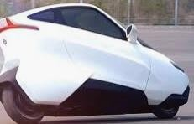
If selected feature is not sufficient
#Wheel Class Label
4 CAR
Pr(CAR| 4) = 75%
Pr(BIKE| 4) = 25%
4
CAR
4
CAR
Pr(CAR| 2) = 25%
Pr(BIKE| 2) = 75%
2
BIKE
2
BIKE
2
?
2
BIKE
4
BIKE
2
CAR

Slide 18
If selected feature is not sufficient
#Wheel Class Label
4 CAR
Pr(CAR| 4) = 75%
Pr(BIKE| 4) = 25%
4
CAR
4
CAR
Pr(CAR| 2) = 25%
Pr(BIKE| 2) = 75%
2
BIKE
2
BIKE
2
BIKE
2
BIKE
4
BIKE
Pr(BIKE|2) > Pr(CAR|2) => BIKE
2
CAR

Slide 19
More Features
#Wheel
4
Height
Class Label
CAR
H: High, height >= 5
H
L: Low, height < 5
4
H
CAR
4
H
CAR
2
L
BIKE
2
L
BIKE
2
L
BIKE
4
L
BIKE
2
H
CAR

Slide 20
Estimate the probabilities, and ask the same question
#Wheel Height Class Label
4 H CAR
Pr(CAR| 4,H) = 100% Pr(BIKE| 4,L) = 100%
Pr(CAR| 2,H) = 100% Pr(BIKE| 2,L) = 100% Pr(CAR| 4,L) = 0%
Pr(BIKE|4,H) = 0% Pr(CAR| 2,L) = 0% Pr(BIKE| 2,H) = 0%
4 | H | CAR
4 | H | CAR
2 | L | BIKE
2 | L | BIKE
2 | L | BIKE
4 | L | BIKE
{2
H}
?
2
H
CAR

Slide 21
Estimate the probabilities, and ask the same question
#Wheel Height Class Label
4 H CAR
Pr(CAR| 4,H) = 100% Pr(BIKE| 4,L) = 100%
Pr(CAR| 2,H) = 100% Pr(BIKE| 2,L) = 100% Pr(CAR| 4,L) = 0%
Pr(BIKE|4,H) = 0% Pr(CAR| 2,L) = 0% Pr(BIKE| 2,H) = 0%
4 | H | CAR
4 | H | CAR
2 | L | BIKE
2 | L | BIKE
2 | L | BIKE
4
L
BIKE
CAR
{2
H}
2
H
CAR

Slide 22
Multiple ways
#Wheel
4
Height
Class Label
CAR
H
Height
H
L
4 | H | CAR
4 | H | CAR
2 | L | BIKE
2 | L | BIKE
2 | L | BIKE
4 | L | BIKE
3
5
#Wheel
2
H
CAR
22

Slide 23

Multiple ways
#Wheel
4
Height
Class Label
CAR
H
Height
H
L
4 | H | CAR
4 | H | CAR
2 | L | BIKE
2 | L | BIKE
2 | L | BIKE
4 | L | BIKE
3
5
#Wheel
#Wheel = 4?
Yes
No
#Height = H?
#Height = H?
No
Yes
No
Yes
2
H
CAR

Slide 24
Summary
Identify the features
Represent the vehicles by the features
Remove non-informative features
Build the classification model from the data
Perform the classification task

Slide 25
A Complete guide to Understand Classification in Machine Learning
Machine learning is connected with the field of education related to algorithms which continuously keeps on learning from various examples and then applying them to real-world problems. Classification is a task of Machine Learning which assigns a label value to a specific class and then can identify a particular type to be of one kind or another. The most basic example can be of the mail spam filtration system where one can classify a mail as either “spam” or “not spam”. You will encounter multiple types of classification challenges and there exist some specific approaches for the type of model that might be used for each challenge.

Slide 26
.
Classification usually refers to any kind of problem where a specific type of class label is the result to be predicted from the given input field of data. Some types of Classification challenges are:
Classifying emails as spam or not
Classify a given handwritten character to be either a known character or not
Classify recent user behaviour as churn or not
For any model, you will require a training dataset with many examples of inputs and outputs from which the model will train itself. The training data must include all the possible scenarios of the problem and must have sufficient data for each label for the model to be trained correctly. Class labels are often returned as string values and hence needs to be encoded into an integer like either representing 0 for “spam” and 1 for “no-spam”.

Slide 27
.
There is no general theory for the best model but one is expected to experiment and discover which algorithm and configuration will result in the best performance for a specific task. In classification predictive modelling, the various algorithms are compared with their results. Classification accuracy is an interesting metric to evaluate the performance of any model based on the various predicted class labels. Classification accuracy might not be the best parameter but is a good point to begin for most of the classification tasks.
In place of a class label, some might give us the prediction of a probability of class membership of a particular input and in such cases, the ROC curve can be a helpful indicator of how accurate one model is. There are mainly 4 different types of classification tasks that you might encounter in your day to day challenges.

Slide 28
.
Generally, the different types of predictive models in machine learning are as follows :
Binary classification
Multi-Label Classification
Multi-Class Classification
Imbalanced Classification

Slide 29
Binary Classification for Machine Learning
A binary classification refers to those tasks which can give either of any two class labels as the output. Generally, one is considered as the normal state and the other is considered to be the abnormal state. The following examples will help you to understand them better.
Email Spam detection: Normal State – Not Spam, Abnormal State – Spam
Conversion prediction: Normal State – Not churned, Abnormal State – Churn
Conversion Prediction: Normal State – Bought an item, Abnormal State – Not bought an item
You can also add the example of that ” No cancer detected” to be a normal state and ” Cancer detected” to be the abnormal state. The notation mostly followed is that the normal state gets assigned the value of 0 and the class with the abnormal state gets assigned the value of 1. For each example, one can also create a model which predicts the Bernoulli probability for the output. In short, it returns a discrete value that covers all cases and will give the output as either the outcome will have a value of 1 or 0. Hence after the association to two different states, the model can give an output for either of the values present.

Slide 30
.
The most popular algorithms which are used for binary classification are :
K-Nearest Neighbours
Logistic Regression
Support Vector Machine
Decision Trees
Naive Bayes
Out of the mentioned algorithms, some algorithms were specifically designed for the purpose of binary classification and natively do not support more than two types of class. Some examples of such algorithms are Support Vector Machines and Logistic Regression. Now we will create a dataset of our own and use binary classification on it. We will use the make_blob() function of the scikit-learn module to generate a binary classification dataset. The example below uses a dataset with 1000 examples that belong to either of the two classes present with two input features.

Slide 31
Code
from numpy import where
from collections import Counter
from sklearn.datasets import make_blobs
from matplotlib import pyplot
X, y = make_blobs(n_samples=5000, centers=2, random_state=1)
print(X.shape, y.shape)
counter = Counter(y)
print(counter)
for i in range(10):
print(X[i], y[i])
for label, _ in counter.items():
row_ix = where(y == label)[0]
pyplot.scatter(X[row_ix, 0], X[row_ix, 1], label=str(label))
pyplot.legend()
pyplot.show()

Slide 32
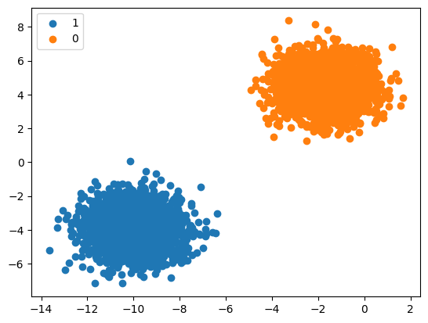
(5000, 2) (5000,) Counter({1: 2500, 0: 2500}) [-11.5739555 -3.2062213] 1 [0.05752883 3.60221288] 0 [-1.03619773 3.97153319] 0 [-8.22983437 -3.54309524] 1 [-10.49210036 -4.70600004] 1 [-10.74348914 -5.9057007 ] 1 [-3.20386867 4.51629714] 0 [-1.98063705 4.9672959 ] 0 [-8.61268072 -3.6579652 ] 1 [-10.54840697 -2.91203705] 1

Slide 33
.
The above example creates a dataset of 5000 samples and divides them into input ‘X’ and output ‘Y’ elements. The distribution shows us that anyone instance can either belong to either class 0 or class 1 and there are approximately 50% in each.
The first 10 examples in the dataset are shown with the input values which are numeric and the target value is an integer which represents a class membership.
Then a scatter plot is created for the input variables where the resultant points are colour coded based on the class value. We can easily see two distinct clusters which we can discriminate.

Slide 34
Multi-Class Classification
These types of classification problems have no fixed two labels but can have any number of labels. Some popular examples of multi-class classification are :
Plant Species Classification
Face Classification
Optical Character recognition
Here there is no notion of a normal and abnormal outcome but the result will belong to one of many among a range of variables of known classes. There can also be a huge number of labels like predicting a picture as to how closely it might belong to one out of the tens of thousands of the faces of the recognition system.
Another type of challenge where you need to predict the next word of a sequence like a translation model for text could also be considered as multi-class classification. In this particular scenario, all the words of the vocabulary define all the possible number of classes and that can range in millions.

Slide 35
.
These types of models are generally done using a Categorical Distribution unlike Bernoulli for binary classification. In a Categorical Distribution, an event can have multiple endpoints or results and hence the model predicts the probability of input with respect to each of the output labels.
The most common algorithms which are used for Multi-Class Classification are :
K-Nearest Neighbours
Naive Bayes
Decision trees
Gradient Boosting
Random Forest

Slide 36
.
You can also use the algorithms for Binary Classification here on a basis of either one class vs all the other classes, also known as one-vs-rest, or one model for a pair of classes in the model which is also known as one-vs-one.
One Vs Rest – The main task here is to fit one model for each class which will be versus all the other classes
One Vs One – The main task here is to define a binary model for every pair of classes.
We will again take the example of multi-class classification by using the make_blobs() function of the scikit learn module. The following code demonstrates it.

Slide 37
Code
from numpy import where
from collections import Counter
from sklearn.datasets import make_blobs
from matplotlib import pyplot
X, y = make_blobs(n_samples=1000, centers=4, random_state=1)
print(X.shape, y.shape)
counter = Counter(y)
print(counter)
for i in range(10):
print(X[i], y[i])
for label, _ in counter.items():
row_ix = where(y == label)[0]
pyplot.scatter(X[row_ix, 0], X[row_ix, 1], label=str(label))
pyplot.legend()
pyplot.show()

Slide 38
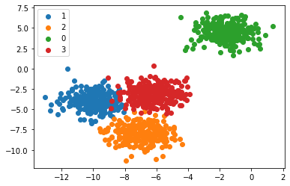
Output
(1000, 2) (1000,)
Counter({1: 250, 2: 250, 0: 250, 3: 250})
[-10.45765533 -3.30899488] 1
[-5.90962043 -7.80717036] 2
[-1.00497975 4.35530142] 0
[-6.63784922 -4.52085249] 3
[-6.3466658 -8.89940182] 2
[-4.67047183 -3.35527602] 3
[-5.62742066 -1.70195987] 3
[-6.91064247 -2.83731201] 3
[-1.76490462 5.03668554] 0
[-8.70416288 -4.39234621] 1
Here we can see that there are more than two
class types and we can classify them separately
into the different types.

Slide 39
Multi-Label Classification for Machine Learning
In multi-label Classification, we refer to those specific classification tasks where we need to assign two or more specific class labels that could be predicted for each example. A basic example can be photo classification where a single photo can have multiple objects in it like a dog or an apple and etcetera. The main difference is the ability to predict multiple labels and not just one.
You cannot use a binary classification model or a multi-class classification model for multi-label classification and you have to use a modified version of the algorithm to incorporate for multiple classes which can be possible and then to look for them all. It becomes more challenging than a simple yes or no statement.

Slide 40
.
The common algorithms used here are :
Multi-label Random Forests
Multi-label Decision trees
Multi-label Gradient Boosting
One more approach is to use a separate classification algorithm for the label prediction for each and every type of class. We will use a library from scikit-learn to generate our multi-label classification dataset from scratch. The following code creates and shows the working example of multi-label classification of 1000 samples and 4 types of classes.

Slide 41
Code
from sklearn.datasets import make_multilabel_classification
X, y = make_multilabel_classification(n_samples=1000, n_features=3, n_classes=4, n_labels=4, random_state=1)
print(X.shape, y.shape)
for i in range(10):
print(X[i], y[i])

Slide 42
Output
(1000, 3) (1000, 4)
[ 8. 11. 13.] [1 1 0 1]
[ 5. 15. 21.] [1 1 0 1]
[15. 30. 14.] [1 0 0 0]
[ 3. 15. 40.] [0 1 0 0]
[ 7. 22. 14.] [1 0 0 1]
[12. 28. 15.] [1 0 0 0]
[ 7. 30. 24.] [1 1 0 1]
[15. 30. 14.] [1 1 1 1]
[10. 23. 21.] [1 1 1 1]
[10. 19. 16.] [1 1 0 1]

Slide 43
Imbalanced Classification for Machine Learning
An Imbalanced Classification refers to those tasks where the number of examples in each of the classes are unequally distributed. Generally, imbalanced classification tasks are binary classification jobs where a major portion of the training dataset is of the normal class type and a minority of them belong to the abnormal class.
The most important examples of these use cases are :
Fraud Detection
Outlier Detection
Medical Diagnosis Test
The problems are transformed into binary classification tasks with some specialized techniques. You can either utilise undersampling for the majority classes or oversampling for the minority classes. The most prominent examples are :
Random Undersampling
SMOTE Oversampling

Slide 44
.
Special modelling algorithms can be used to give more attention to the minority class when the model is being fitted on the training dataset which includes cost-sensitive machine learning models. Especially for cases like :
Cost-Sensitive Logistic Regression
Cost-Sensitive Decision Trees
Cost-Sensitive Support Vector Machines
So after choosing the model, we need to access the model and score it for which we can either use Precision, Recall or F-Measure score. Now we will take a look to develop a dataset for the imbalanced classification problem. We will use the Classification function of scikit-learn to generate a fully synthetic and imbalanced binary classification dataset of 1000 samples

Slide 45
Code
from numpy import where
from collections import Counter
from sklearn.datasets import make_classification
from matplotlib import pyplot
X, y = make_classification(n_samples=1000, n_features=2, n_informative=2, n_redundant=0, n_classes=2, n_clusters_per_class=1, weights=[0.99,0.01], random_state=1)
print(X.shape, y.shape)
counter = Counter(y)
print(counter)
for i in range(10):
print(X[i], y[i])
for label, _ in counter.items():
row_ix = where(y == label)[0]
pyplot.scatter(X[row_ix, 0], X[row_ix, 1], label=str(label))
pyplot.legend()
pyplot.show()

Slide 46
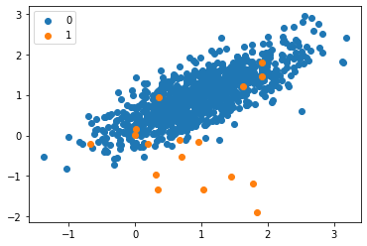
Output
Here we can see the distribution of the labels and we can see a severe imbalance of the classes where 983 elements belong to one type and only 17 belong to the other type. We can see a majority of type 0 or class 0 as expected. These types of datasets are more difficult to identify but they have a more general and practical use case.
(1000, 2) (1000,)
Counter({0: 983, 1: 17})
[0.86924745 1.18613612] 0
[1.55110839 1.81032905] 0
[1.29361936 1.01094607] 0
[1.11988947 1.63251786] 0
[1.04235568 1.12152929] 0
[1.18114858 0.92397607] 0
[1.1365562 1.17652556] 0
[0.46291729 0.72924998] 0
[0.18315826 1.07141766] 0
[0.32411648 0.53515376] 0

Slide 47
.
We now have all the tools in hand to proceed with the implementation of some algorithms. This section will cover four algorithms and their implementation on the loans dataset to illustrate some of the previously covered concepts, especially for the imbalanced datasets using a binary classification task. We will focus on only four algorithms for simplicity’s sake.
The goal is not to have the best possible model but to illustrate how to train each of the following algorithms. The source code is available on the DataCamp Workspace, where you can execute everything with one click.
Distribution of Loans in the Dataset
Look at the first five observations in the dataset.

Slide 48
Code
import pandas as pd
loan_data = pd.read_csv("loan_data.csv")
loan_data.head()

Slide 49
Borrowers profile in the dataset
import matplotlib.pyplot as plt
# Helper function for data distribution
# Visualize the proportion of borrowers
def show_loan_distrib(data):
count = ""
if isinstance(data, pd.DataFrame):
count = data["not.fully.paid"].value_counts()
else:
count = data.value_counts()
count.plot(kind = 'pie', explode = [0, 0.1],
figsize = (6, 6), autopct = '%1.1f%%', shadow = True)
plt.ylabel("Loan: Fully Paid Vs. Not Fully Paid")
plt.legend(["Fully Paid", "Not Fully Paid"])
plt.show()
# Visualize the proportion of borrowers
show_loan_distrib(loan_data)

Slide 50
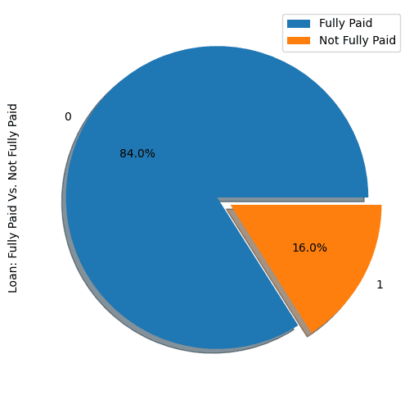
Output
From the graphic above, we notice that 84% of the borrowers paid their loans back, and only 16% didn’t pay them back, which makes the dataset really imbalanced.

Slide 51
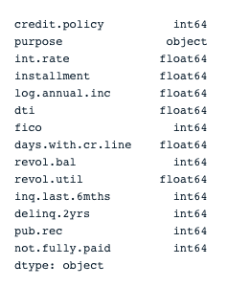
Variable Types
Before further, we need to check the variables’ type so that we can encode those that need to be encoded.
We notice that all the columns are continuous variables, except the purpose attribute, which needs to be encoded.

Slide 52
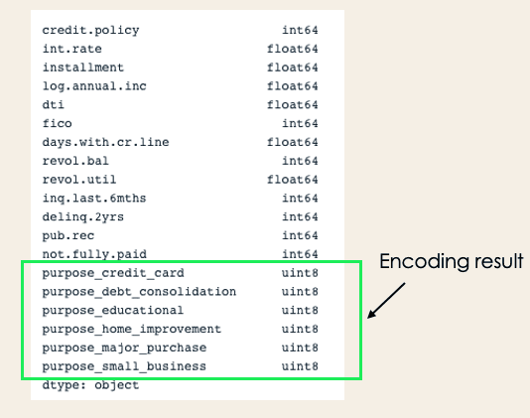
Check column types
print(loan_data.dtypes)

Slide 53
.
encoded_loan_data = pd.get_dummies(loan_data, prefix="purpose", drop_first=True)
print(encoded_loan_data.dtypes)
Separate data into train and test
X = encoded_loan_data.drop('not.fully.paid', axis = 1)
y = encoded_loan_data['not.fully.paid']
X_train, X_test, y_train, y_test = train_test_split(X, y, test_size=0.30,
stratify = y, random_state=2022)

Slide 54
.
Application of the Sampling Strategies
We will explore two sampling strategies here: random undersampling, and SMOTE oversampling.
Random Undersampling
We will undersample the majority class, which corresponds to the “fully paid” (class 0).
X_train_cp = X_train.copy()
X_train_cp['not.fully.paid'] = y_train
y_0 = X_train_cp[X_train_cp['not.fully.paid'] == 0]
y_1 = X_train_cp[X_train_cp['not.fully.paid'] == 1]
y_0_undersample = y_0.sample(y_1.shape[0])
loan_data_undersample = pd.concat([y_0_undersample, y_1], axis = 0)
# Visualize the proportion of borrowers
show_loan_distrib(loan_data_undersample)

Slide 55
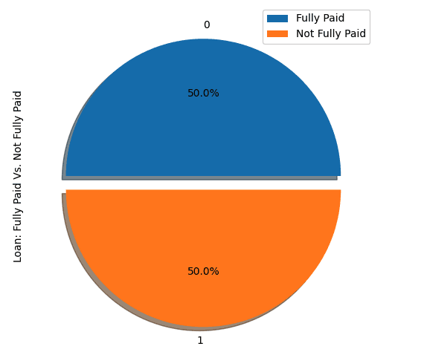
.

Slide 56
.
SMOTE Oversampling
Perform oversampling on the minority class
smote = SMOTE(sampling_strategy='minority')
X_train_SMOTE, y_train_SMOTE = smote.fit_resample(X_train,y_train)
# Visualize the proportion of borrowers
show_loan_distrib(y_train_SMOTE)
After applying the sampling strategies, we observe that the dataset is equally distributed across the different types of borrowers.

Slide 57
Application of Some Machine Learning Classification Algorithms
This section will apply these two classification algorithms to the SMOTE smote sampled dataset. The same training approach can be applied to undersampled data as well.
Logistic Regression
This is an explainable algorithm. It classifies a data point by modeling its probability of belonging to a given class using the sigmoid function.
X = loan_data_undersample.drop('not.fully.paid', axis = 1)
y = loan_data_undersample['not.fully.paid']
X_train, X_test, y_train, y_test = train_test_split(X, y, test_size=0.15, stratify = y, random_state=2022)
logistic_classifier = LogisticRegression()
logistic_classifier.fit(X_train, y_train)
y_pred = logistic_classifier.predict(X_test)
print(confusion_matrix(y_test,y_pred))
print(classification_report(y_test,y_pred))

Slide 58
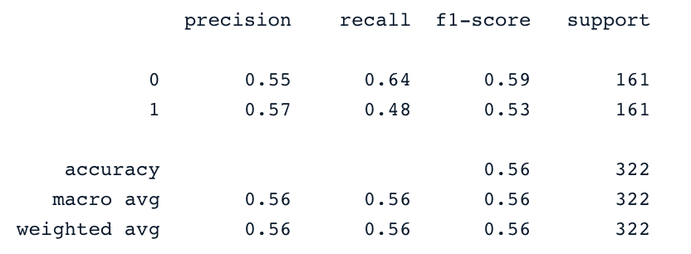
.
.

Slide 59
Support Vector Machines
This algorithm can be used for both classification and regression. It learns to draw the hyperplane (decision boundary) by using the margin to maximization principle. This decision boundary is drawn through the two closest support vectors.
SVM provides a transformation strategy called kernel tricks used to project non-learner separable data onto a higher dimension space to make them linearly separable.
from sklearn.svm import SVC
svc_classifier = SVC(kernel='linear')
svc_classifier.fit(X_train, y_train)
# Make Prediction & print the result
y_pred = svc_classifier.predict(X_test)
print(classification_report(y_test,y_pred))

Slide 60
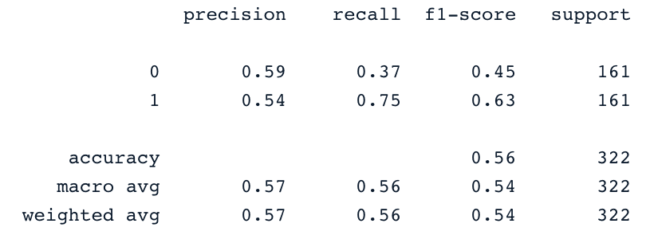
.
.
These results can be of course improved with more feature engineering and fine-tuning. But they are better than using the original imbalanced data.

